Slide 1
Machine Learning

Slide 2
Introduction
Machine Learning: a buzzword for past few years
Reasons
high amount of data production by applications
increase of computation power in the past few years
development of better algorithms.
Automating mundane tasks to offer intelligent insights, industries
You may already be using a device that utilizes it.
a wearable fitness tracker like Fitbit
an intelligent home assistant like Google Home.

Slide 3
Applications
Much more examples of ML in use.
Prediction
Image Recognition — face detection, speech recognition, voice searches and more.
Medical Diagnoses — ML is trained to recognize cancerous tissues.
Financial industry and trading — companies use ML in fraud investigations and credit checks.

Slide 4
What is Machine Learning
Machine Learning algorithms enable the computers to learn from data, and even improve themselves, without being explicitly programmed.
- Arthur Samuel
Machine learning (ML) is a category of an algorithm that allows software applications to become more accurate in predicting outcomes without being explicitly programmed.
The basic premise of machine learning is to build algorithms that can receive input data and use statistical analysis to predict an output while updating outputs as new data becomes available.

Slide 5
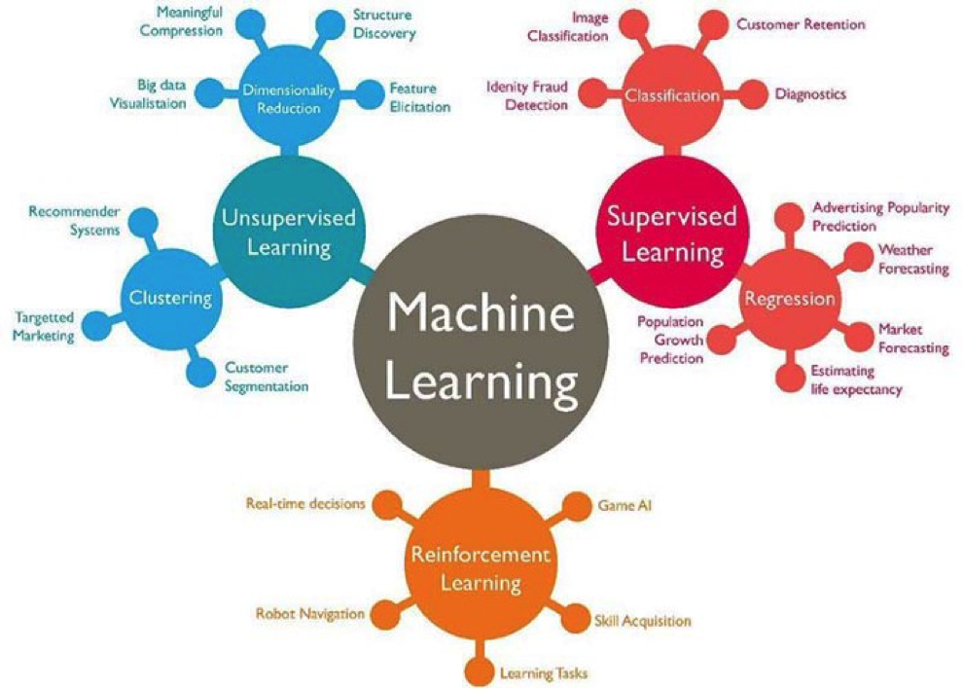
Types of ML Algorithms
Machine learning can be classified into 3 types of algorithms.
Supervised Learning
Unsupervised Learning
Reinforcement Learning

Slide 6
Supervised Learning Algorithm
An AI system is presented with data which is labeled, which means that each data tagged with the correct label.
Goal is to approximate the mapping function so well that when you have new input data (x), you can predict the output variables (Y) for that data.

Slide 7
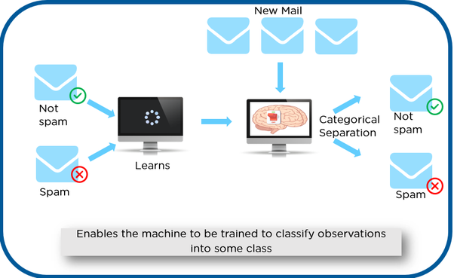
Supervised Learning Algorithm
‘Spam’ or ‘Not Spam’. This labeled data is used to train supervised model.
Once it is trained, we can test our model with some test new mails and checking of the model is able to predict the right output.

Slide 8
Supervised Learning Algorithm
Types of Supervised learning
Classification: A classification problem is when the output variable is a category, such as “red” or “blue” or “disease” and “no disease”.
Regression: A regression problem is when the output variable is a real value, such as “dollars” or “weight”.

Slide 9
Unsupervised Learning Algorithm
An AI system is presented with unlabeled, uncategorized data and the system’s algorithms act on the data without prior training.
The output is dependent upon the coded algorithms. Subjecting a system to unsupervised learning is one way of testing AI.

Slide 10
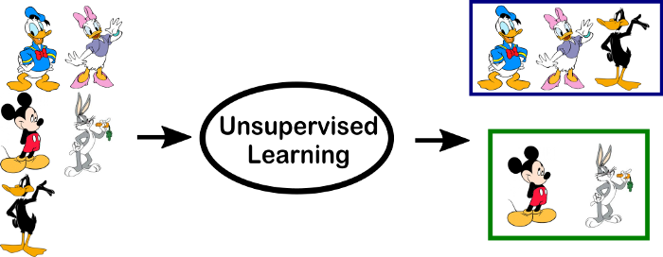
Unsupervised Learning Algorithm
In the above example, we have given some characters to our model which are ‘Ducks’ and ‘Not Ducks’. In our training data, we don’t provide any label to the corresponding data.
The unsupervised model is able to separate both the characters by looking at the type of data and models the underlying structure or distribution in the data in order to learn more about it.

Slide 11
Unsupervised Learning Algorithm
Types of Unsupervised learning
Clustering: A clustering problem is where you want to discover inherent groupings in the data, such as grouping customers by purchasing behavior.
Association: An association rule learning problem is where you want to discover rules that describe large portions of your data, such as people that buy X also tend to buy Y.

Slide 12
Reinforcement Learning Algorithm
A reinforcement learning algorithm, or agent, learns by interacting with its environment.
Agent receives rewards by performing correctly and penalties for performing incorrectly.
Agent learns without intervention from a human by maximizing its reward and minimizing its penalty.
It is a type of dynamic programming that trains algorithms using a system of reward and punishment.

Slide 13
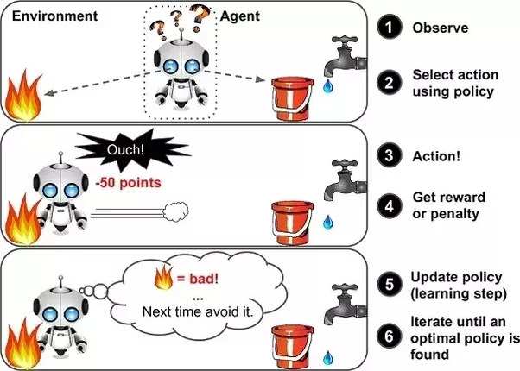
Reinforcement Learning Algorithm
agent is given 2 options i.e. a path with water or a path with fire.
A reinforcement algorithm works on reward a system i.e. if the agent uses the fire path then the rewards are subtracted and agent tries to learn that it should avoid the fire path.
If it had chosen the water path or the safe path then some points would have been added to the reward points, the agent then would try to learn what path is safe and what path isn’t.
Basically leveraging rewards obtained, agent improves its environment knowledge to select the next action.

